Slide 1




INTERNSHIP / UDP / TRAINING REPORT
(Monthly Progress Report)
1. Student Information
Student Name | DHRUVI MUKESHBHAI MALANKIYA
Enrollment Number | 23SE02CE056
Program/Branch | B.TECH - COMPUTER ENGINEERING
Semester | 7
Contact Number | 9313779161
Email ID | 23se02ce056@ppsu.ac.in
2. Internship / UDP / Training Details
Type | INTERNSHIP
Company/Organization | DURVASA INFOTECH
Department/Domain | PYTHON DATA SCIENCE (AI / ML)
Mentor Name (Company) | DARSHAN CHAUHAN
Mentor Name (Institute) | DR. JAYSHRI PATIL
Start Date | 01/06/2026
End Date | 15/10/2026
3. Work Progress Summary
a)Project Title:
Smart Healthcare Analytics Dashboard for Disease Prediction

Slide 2
b)Problem Statement:
Nowadays, many people do not know about their health risks at an early stage. Diseases like diabetes, heart
disease, and blood pressure problems are increasing day by day. Early prediction can help people take proper care
of their health. This project will help in analyzing health data and predicting disease risks using AI and Machine
Learning.
c)Objectives:
•
To analyze health-related data.
•
To predict disease risks using AI/ML.
•
To create a dashboard for health analysis.
•
To provide health suggestions and recommendations.
•
To help users track their daily health activities.
d)Proposed Methodology:
•
Collect healthcare dataset.
•
Clean and analyze the data.
•
Train machine learning model.
•
Build dashboard using Python and Streamlit.
•
Predict disease risks based on user health data.
•
Provide suggestions and daily tracking system.

Slide 3
e)Expected Outcomes:
•
Disease risk prediction system.
•
Smart healthcare dashboard.
•
Health recommendations for users.
•
Daily health tracking and progress monitoring.
f)Future Scope:
•
Cloud deployment for online access.
•
Multi-user support with login system.
•
Friend comparison and leaderboard system.
•
Reward and coupon-based motivation system.
•
Integration with wearable devices and health sensors.
4. Tasks Accomplished
•
Internship project domains explored.
•
Project ideas discussed and analyzed.
•
Final project selected. Project title finalized.
•
Features and modules identified.
•
Project workflow designed.
•
Offline/local server architecture decided.
5. Tasks in Progress / Next Plan
•
Dataset collection.
•
Dataset preprocessing and cleaning.
•
Machine learning model selection.
•
Initial UI design planning using Streamlit.

Slide 4
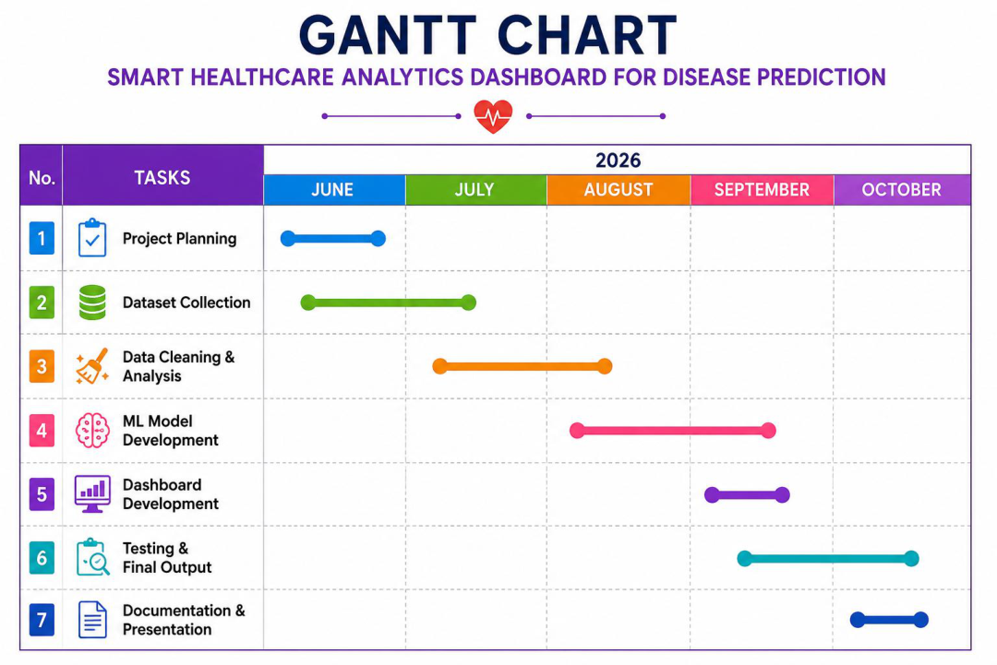
6. Learnings / Skills Acquired
•
Understanding of AI/ML healthcare project planning.
•
Knowledge of project architecture and workflow.
•
Basic understanding of local server deployment.
•
Improved knowledge in project design and module planning
Gantt Chart :

Slide 5
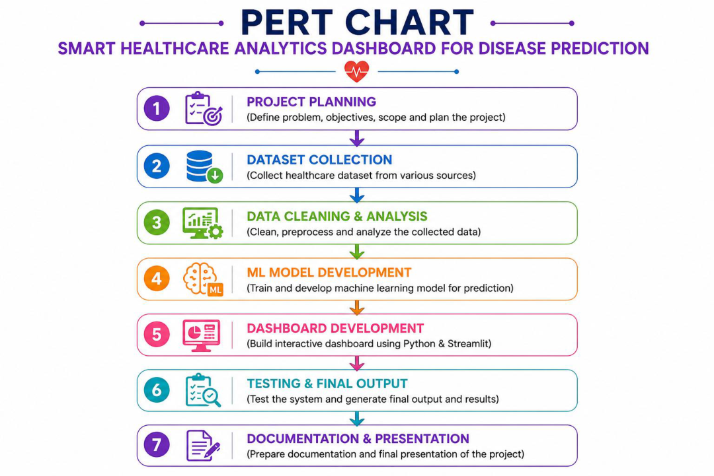
PERT Chart :

Slide 6
Evaluation (To be filled by Mentor (Institute))
Criteria | Bloom’s Level | Excellent (20) | Good (15) | Average (10) | Poor (5) | Marks Obtained (Out of 20)
Problem Definition | L4–Analyze | Clearly defined, justified real- world problem | Defined but lacks depth | Vague problem | No clear problem
Project Title Relevance | L2– Understand | Highly precise and aligned | Mostly relevant | Partially relevant | Misleading
Scope of Work | L5–Evaluate | Well-defined scope, deliverables, constraints | Defined with minor gaps | Broad/unclear | No scope
Literature Study | L4–Analyze | 3–5 sources analyzed critically | Sources listed | Minimal references | No study
Clarity & Presentation | L3–Apply | Structured, professional | Minor issues | Some confusion | Poor
Total Marks
Evaluation
Student Signature | Mentor (Company) Signature | Mentor (Institute) Signature

Slide 7
Mentor (Institute) Remarks
____________________________________________________________________________________________________________________________________
____________________________________________________________________________________________________________________________________
____________________________________________________________________________________________________________________________________
____________________________________________________________________________________________________________________________________
____________________________________________________________________________________________________________________________________
____________________________________________________________________________________________________________________________________
____________________________________________________________________________________________________________________________________
____________________________________________________________________________________________________________________________________
____________________________________________________________________________________________________________________________________
____________________________________________________________________________________________________________________________________

